Slide 1
A MACHINE LEARNING-BASED CLASSIFICATION AND PREDICTION TECHNIQUE FOR DDOS ATTACKS

Slide 2
Abstract
This project focuses on detecting and classifying Distributed Denial of Service (DDoS) attacks using machine learning models. Leveraging the IDS 2017 dataset, we preprocess, explore, and train models like Random Forest, Logistic Regression, and Neural Networks. The models are evaluated using metrics such as accuracy, F1 score, and AUC to ensure robust performance. Through this approach, we aim to enhance the reliability of network security systems.

Slide 3
Introduction
Distributed Denial of Service (DDoS) attacks pose a critical threat to the stability of online services, making their detection essential for network security. This project utilizes the IDS 2017 dataset to classify DDoS attacks using machine learning models. By employing algorithms such as Random Forest, Logistic Regression, and Neural Networks, the project aims to identify malicious traffic effectively. Comprehensive evaluation metrics ensure the development of a robust detection system.
DDoS attacks are a major challenge to the reliability of online services, requiring effective detection mechanisms. This project uses the IDS 2017 dataset to classify DDoS attacks with machine learning models like Random Forest and Neural Networks. It emphasizes robust evaluation to build a reliable and efficient detection system.

Slide 4
Existing System
Existing DDoS detection systems often rely on traditional rule-based methods and threshold-based monitoring techniques. While effective to some extent, these approaches struggle to adapt to evolving attack patterns and large-scale traffic. Signature-based systems require frequent updates, and anomaly detection systems may produce high false-positive rates.
Additionally, these methods lack the scalability and real-time capabilities required for modern networks. As a result, there is a growing need for machine learning-based solutions to address these limitations.

Slide 5
Proposed System
The proposed system leverages machine learning models to detect and classify DDoS attacks more accurately and efficiently. Using the IDS 2017 dataset, the system preprocesses network traffic data, trains models such as Random Forest, Logistic Regression, and Neural Networks, and evaluates their performance with metrics like accuracy, F1 score, and AUC.
This approach enables adaptive detection, reducing false positives and improving scalability for real-time applications. By automating the learning of attack patterns, the system offers a robust and reliable solution for modern network security challenges.

Slide 6
LITERATURE REVIEW
Several studies have explored DDoS detection using traditional and machine learning approaches. Signature-based methods like Snort rely on known attack patterns but fail against novel threats. Anomaly-based systems, while adaptable, often suffer from high false-positive rates. Recent research highlights the effectiveness of machine learning models, such as Random Forest and Neural Networks, in improving detection accuracy and scalability. However, challenges like feature selection and model optimization remain critical areas for further investigation.

Slide 7
Module
Pandas: For data manipulation and analysis.
NumPy: For numerical computations.
Matplotlib & Seaborn: For visualizing data distributions and relationships.
Scikit-learn: For implementing machine learning models and evaluation metrics.

Slide 8
Algorithms Used:
Random Forest: An ensemble learning method using multiple decision trees for improved classification accuracy.
Logistic Regression: A statistical model for binary classification of data.
Neural Network (MLPClassifier): A deep learning model designed to capture complex patterns in the data.
Support Vector Machine (SVC): A supervised learning model that separates data using hyperplanes for effective classification.

Slide 9
Software Components:
1.Python
2.Jupyter
3. Anaconda Navigator
Hardware Components:
Camera/Camera Module
GPU (Graphics Processing Unit)
CPU (Central Processing Unit)
RAM (Random Access Memory)
Storage
Edge Device (Optional)
Power Supply

Slide 10
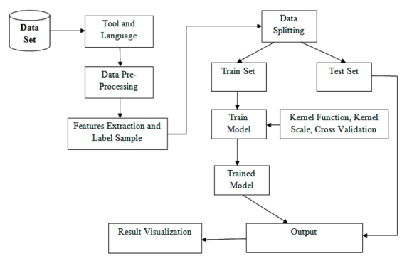
Block Diagram

Slide 11
UML Diagrams
Use Case Diagram
Data Flow Diagram
Sequence Diagram
State Diagram

Slide 12
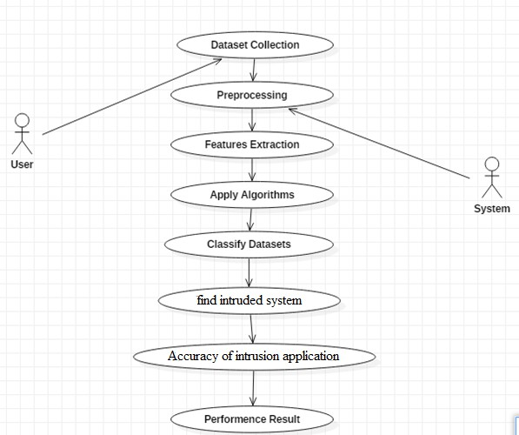
Usecase Diagrams

Slide 13
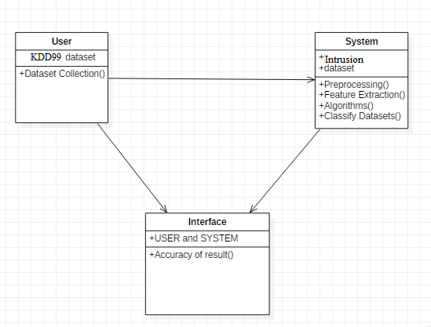
Class Diagrams

Slide 14
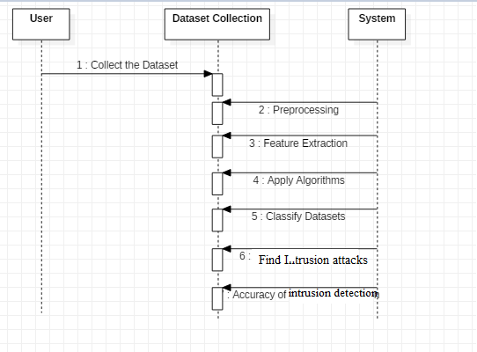
Sequance Diagrams

Slide 15
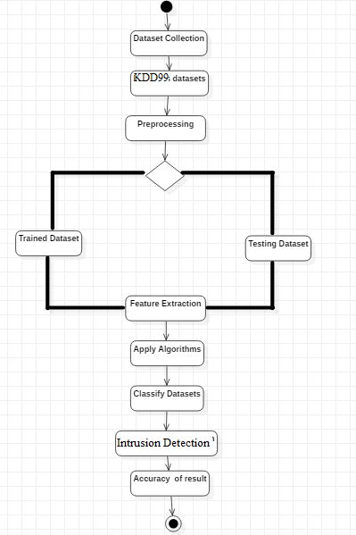
Activity Diagrams

Slide 16
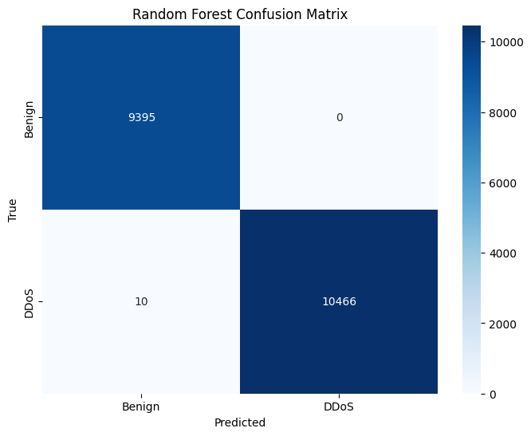
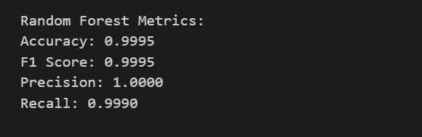
Final Output
The output of this project includes the classification of network traffic into normal and DDoS attack categories. Models are evaluated using metrics like accuracy, F1 score, and AUC to determine their effectiveness. Visualizations such as ROC curves and confusion matrices highlight model performance and detection reliability.
1. Random Forest Result

Slide 17
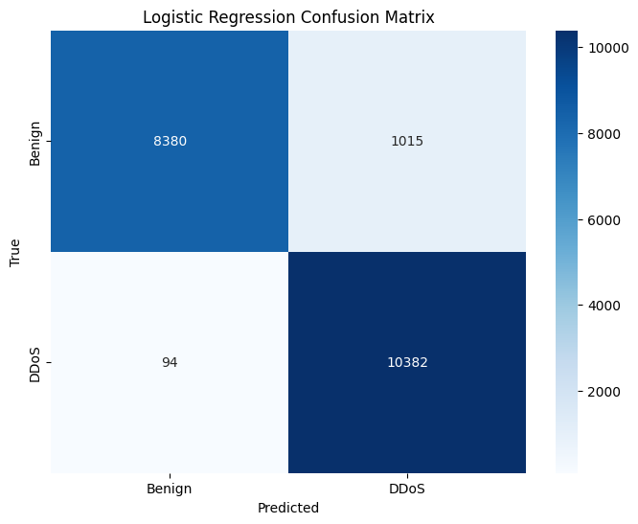
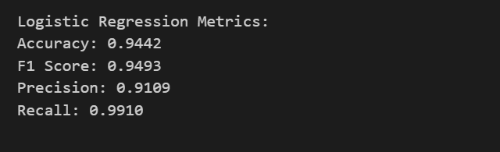
Final Output
2.Logistic Regression

Slide 18

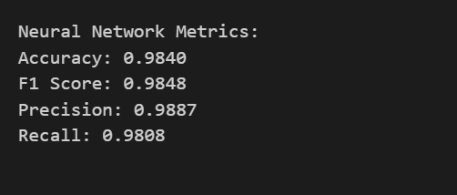
Final Output
3. Neural Network

Slide 19
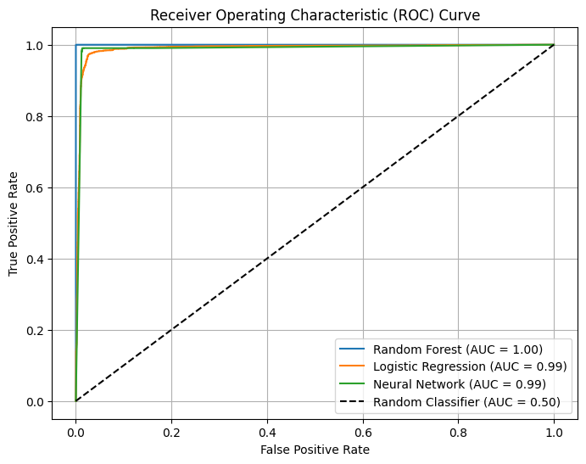
Final Output
'Receiver Operating Characteristic (ROC) Curve

Slide 20
Conclusion
This project successfully demonstrates the classification of DDoS attacks using machine learning models, leveraging the IDS 2017 dataset for robust analysis. By employing Random Forest, Logistic Regression, and Neural Networks, the system achieves reliable performance in distinguishing between benign and malicious traffic. Comprehensive evaluation metrics validate the effectiveness of the models and their suitability for real-world deployment. The results highlight the potential of machine learning in enhancing network security and reducing false-positive rates. Future work can focus on optimizing models and integrating real-time detection capabilities.

